Slide 1
The Foundations: Logic and Proofs
Chapter 1, Part I: Propositional Logic
Part II: Predicate Logic
Part III: Proofs

Slide 2
Chapter Summary
Propositional Logic
The Language of Propositions
Applications
Logical Equivalences
Predicate Logic
The Language of Quantifiers
Logical Equivalences
Nested Quantifiers
Proofs
Rules of Inference
Proof Methods
Proof Strategy

Slide 3
Propositional Logic
Section 1.1

Slide 4
Section Summary
Propositions
Connectives
Negation
Conjunction
Disjunction
Implication; contrapositive, inverse, converse
Biconditional
Truth Tables

Slide 5
Propositions
A proposition is a declarative sentence that is either true or false.
Examples of propositions:
The Moon is made of green cheese.
Trenton is the capital of New Jersey.
Toronto is the capital of Canada.
1 + 0 = 1
0 + 0 = 2
Examples that are not propositions.
Sit down!
What time is it?
x + 1 = 2
x + y = z

Slide 6
Propositional Logic
Constructing Propositions
Propositional Variables: p, q, r, s, …
The proposition that is always true is denoted by T and the proposition that is always false is denoted by F.
Compound Propositions; constructed from logical connectives and other propositions
Negation ¬
Conjunction ∧
Disjunction ∨
Implication →
Biconditional ↔

Slide 7
Compound Propositions: Negation
The negation of a proposition p is denoted by ¬p and has this truth table:
Example: If p denotes “The earth is round.”, then ¬p denotes “It is not the case that the earth is round,” or more simply “The earth is not round.”
p | ¬p
T | F
F | T

Slide 8
Conjunction
The conjunction of propositions p and q is denoted by p ∧ q and has this truth table:
Example: If p denotes “I am at home.” and q denotes “It is raining.” then p ∧q denotes “I am at home and it is raining.”
p | q | p ∧ q
T | T | T
T | F | F
F | T | F
F | F | F

Slide 9
Disjunction
The disjunction of propositions p and q is denoted by p ∨q and has this truth table:
Example: If p denotes “I am at home.” and q denotes “It is raining.” then p ∨q denotes “I am at home or it is raining.”
p | q | p ∨q
T | T | T
T | F | T
F | T | T
F | F | F

Slide 10
The Connective Or in English
In English “or” has two distinct meanings.
“Inclusive Or” - In the sentence “Students who have taken CS202 or Math120 may take this class,” we assume that students need to have taken one of the prerequisites, but may have taken both. This is the meaning of disjunction. For p ∨q to be true, either one or both of p and q must be true.
“Exclusive Or” - When reading the sentence “Soup or salad comes with this entrée,” we do not expect to be able to get both soup and salad. This is the meaning of Exclusive Or (Xor). In p ⊕ q , one of p and q must be true, but not both. The truth table for ⊕ is:
p | q | p ⊕q
T | T | F
T | F | T
F | T | T
F | F | F

Slide 11
Implication
If p and q are propositions, then p →q is a conditional statement or implication which is read as “if p, then q ” and has this truth table:
Example p: You never sleep in class
q: You will pass the final exam
In p →q , p is the hypothesis (antecedent or premise) and q is the conclusion (or consequence).
p | q | p →q
T | T | T
T | F | F
F | T | T
F | F | T

Slide 12
Understanding Implication
In p →q there does not need to be any connection between the antecedent or the consequent. The “meaning” of p →q depends only on the truth values of p and q.
These implications are perfectly fine, but would not be used in ordinary English.
“If the moon is made of green cheese, then I have more money than Bill Gates. ”
“If the moon is made of green cheese then I’m on welfare.”
“If 1 + 1 = 3, then your grandma wears combat boots.”

Slide 13
Understanding Implication (cont)
One way to view the logical conditional is to think of an obligation or contract.
“If I am elected, then I will lower taxes.”
“If you get 100% on the final, then you will get an A.”
If the politician is elected and does not lower taxes, then the voters can say that he or she has broken the campaign pledge. Something similar holds for the professor. This corresponds to the case where p is true and q is false.

Slide 14
Different Ways of Expressing p →q
if p, then q p implies q
if p, q p only if q
q unless ¬p q when p
q if p q when p
q whenever p p is sufficient for q
q follows from p q is necessary for p
a necessary condition for p is q
a sufficient condition for q is p

Slide 15
Converse, Contrapositive, and Inverse
From p →q we can form new conditional statements .
q →p is the converse of p →q
¬q → ¬ p is the contrapositive of p →q
¬ p → ¬ q is the inverse of p →q
Example: Find the converse, inverse, and contrapositive of “It raining is a sufficient condition for my not going to town.”
Solution:
converse: If I do not go to town, then it is raining.
inverse: If it is not raining, then I will go to town.
contrapositive: If I go to town, then it is not raining.

Slide 16
Biconditional
If p and q are propositions, then we can form the biconditional proposition p ↔q , read as “p if and only if q .” The biconditional p ↔q denotes the proposition with this truth table:
If p denotes “I am at home.” and q denotes “It is raining.” then p ↔q denotes “I am at home if and only if it is raining.”
p | q | p ↔q
T | T | T
T | F | F
F | T | F
F | F | T

Slide 17
Biconditional exampe
p : the radius of the two circle are the same
q : the square of the the two circle are equivalent
p ↔ q: the radius of the two circle are the same if and only if the square of the the two circle are equivalent

Slide 18
Expressing the Biconditional
Some alternative ways “p if and only if q” is expressed in English:
p is necessary and sufficient for q
if p then q , and conversely
p iff q

Slide 19
Truth Tables For Compound Propositions
Construction of a truth table:
Rows
Need a row for every possible combination of values for the atomic propositions.
Columns
Need a column for the compound proposition (usually at far right)
Need a column for the truth value of each expression that occurs in the compound proposition as it is built up.
This includes the atomic propositions

Slide 20
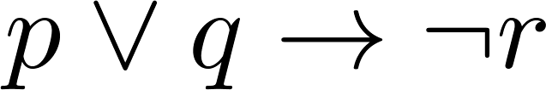
Example Truth Table
Construct a truth table for
p | q | r | ¬r | p ∨ q | p ∨ q → ¬r
T | T | T | F | T | F
T | T | F | T | T | T
T | F | T | F | T | F
T | F | F | T | T | T
F | T | T | F | T | F
F | T | F | T | T | T
F | F | T | F | F | T
F | F | F | T | F | T

Slide 21
Equivalent Propositions
Two propositions are equivalent if they always have the same truth value.
Example: Show using a truth table that the conditional is equivalent to the contrapositive.
Solution:
p | q | ¬ p | ¬ q | p →q | ¬q → ¬ p
T | T | F | F | T | T
T | F | F | T | F | F
F | T | T | F | T | T
F | F | T | T | T | T

Slide 22
Using a Truth Table to Show Non-Equivalence
Example: Show using truth tables that neither the converse nor inverse of an implication are not equivalent to the implication.
Solution:
p | q | ¬ p | ¬ q | p →q | ¬ p →¬ q | q → p
T | T | F | F | T | T | T
T | F | F | T | F | T | T
F | T | T | F | T | F | F
F | F | T | T | T | T | T

Slide 23
Problem
How many rows are there in a truth table with n propositional variables?
Solution: 2^{n} We will see how to do this in Chapter 6.
Note that this means that with n propositional variables, we can construct 2^{n} distinct (i.e., not equivalent) propositions.

Slide 24
Precedence of Logical Operators
Operator | Precedence
¬ | 1
∧ ∨ | 2 3
→ ↔ | 4 5
p ∨q → ¬r is equivalent to (p ∨q) → ¬r
If the intended meaning is p ∨(q → ¬r )
then parentheses must be used.

Slide 25
Logic and Bit Operations
In computer all the information is represented with bits (binary digit). Bit is a symbol with two possible values: 0 (zero), and 1(one) bit can be used to represent truth values:1 for True, 0 for False
Boolean variable is a variable with two possible values (0,1)
Note: Computer operations correspond to the logical operations

Slide 26
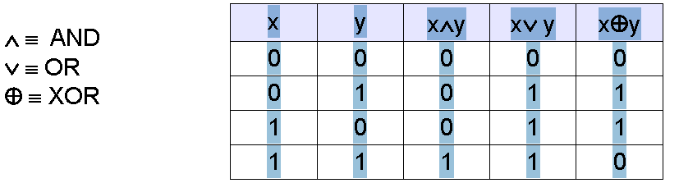
Cont…

Slide 27
Exercise
7th edition
P13, 14(a,c,e)
P14, 23
P15, 33(a,c,f)

Slide 28
Applications of Propositional Logic
Section 1.2

Slide 29
Applications of Propositional Logic: Summary
Translating English to Propositional Logic
System Specifications
Boolean Searching
Logic Puzzles
Logic Circuits
AI Diagnosis Method (Optional)

Slide 30
Overview
Logic has many important applications to mathematics, computer science, and numerous other disciplines. Statements in mathematics and the sciences and in natural language often are imprecise
or ambiguous. To make such statements precise, they can be translated into the language of logic.

Slide 31
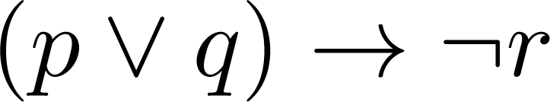
Translating English Sentences
Steps to convert an English sentence to a statement in propositional logic
Identify atomic propositions and represent using propositional variables.
Determine appropriate logical connectives
“If I go to Harry’s or to the country, I will not go shopping.”
p: I go to Harry’s
q: I go to the country.
r: I will go shopping.
If p or q then not r.

Slide 32
Example
Problem: Translate the following sentence into propositional logic:
“You can access the Internet from campus only if you are a computer science major or you are not a freshman.”
One Solution: Let a, c, and f represent respectively “You can access the internet from campus,” “You are a computer science major,” and “You are a freshman.”
a→ (c ∨ ¬ f )

Slide 33
System Specifications
System and Software engineers take requirements in English and express them in a precise specification language based on logic.
Example: Express in propositional logic:
“The automated reply cannot be sent when the file system is full”
Solution: One possible solution: Let p denote “The automated reply can be sent” and q denote “The file system is full.”
q→ ¬ p

Slide 34
Consistent System Specifications
Definition: A list of propositions is consistent if it is possible to assign truth values to the proposition variables so that each proposition is true.
Exercise: Are these specifications consistent?
“The diagnostic message is stored in the buffer or it is retransmitted.”
“The diagnostic message is not stored in the buffer.”
“If the diagnostic message is stored in the buffer, then it is retransmitted.”
Solution: Let p denote “The diagnostic message is stored in the buffer.” Let q denote “The diagnostic message is retransmitted” The specification can be written as: p ∨ q, p→ q, ¬p. When p is false and q is true all three statements are true. So the specification is consistent.
What if “The diagnostic message is not retransmitted is added.”
Solution: Now we are adding ¬q and there is no satisfying assignment. So the specification is not consistent.

Slide 35
Boolean searches
EXAMPLE 6 web search
to find pages that deal with universities in New Mexico or Arizona, we can search for pages matching
(NEW AND MEXICO OR ARIZONA) AND UNIVERSITIES.

Slide 36
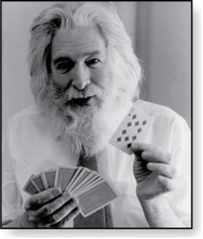
Logic Puzzles
Raymond Smullyan
(Born 1919)
An island has two kinds of inhabitants, knights, who always tell the truth, and knaves, who always lie.
You go to the island and meet A and B.
A says “B is a knight.”
B says “The two of us are of opposite types.”
Example: What are the types of A and B?
Solution: Let p and q be the statements that A is a knight and B is a knight, respectively. So, then ¬p represents the proposition that A is a knave and ¬q that B is a knave.
If A is a knight, then p is true. Since knights tell the truth, q must also be true. Then (p ∧ ¬ q)∨ (¬ p ∧ q) would have to be true, but it is not. So, A is not a knight and therefore ¬p must be true.
If A is a knave, then B must not be a knight since knaves always lie. So, then both ¬p and ¬q hold since both are knaves.
Therefore， (p ∧ ¬ q)∨ (¬ p ∧ q) is true

Slide 37
Cont…(example add)
A says: “at least one of us is a knave”
B says nothing
p: “A is a knight”
q: “B is a knight”
p q ¬p∨¬q
T F F ∨ T = T = (T) A is a knight and
F F T ∨ T = T ≠ (F) B is a knave
F T T ∨ F = T ≠ (F)
T T F ∨ F = F ≠ (T)

Slide 38
Do you know whether you have a muddy forehead?
EXAMPLE 8 A father tells his two children, a boy and a girl, to play in their backyard without getting dirty.
However, while playing, both children get mud on their foreheads. When the children stop playing, the father says “At least one of you has a muddy forehead,” and then asks the children to answer “Yes” or “No” to the question: “Do you know whether you have a muddy forehead?”
The father asks this question twice. What will the children answer each time this question is asked, assuming that a child can see whether his or her sibling has a muddy forehead, but cannot see his or her own forehead? Assume that both children are honest and that the children answer each question simultaneously.

Slide 39
Do you know whether you have a muddy forehead?
Solution: Let s be the statement that the son has a muddy forehead and let d be the statement that the daughter has a muddy forehead. When the father says that at least one of the two children has a muddy forehead, he is stating that the disjunction s ∨ d is true. Both children will answer “No” the first time the question is asked because each sees mud on the other child’s forehead.
That is, the son knows that d is true, but does not know whether s is true, and the daughter knows that s is true, but does not know whether d is true.
After the son has answered “No” to the first question, the daughter can determine that d must be true. This follows because when the first question is asked, the son knows that s ∨ d is true, but cannot determine whether s is true. Using this information, the daughter can conclude that d must be true, for if d were false, the son could have reasoned that because s ∨ d is true, then s must be true, and he would have answered “Yes” to the first question. The son can reason in a similar way to determine that s must be true. It follows that both children answer “Yes” the second time the question is asked.

Slide 40
Exercise
Pages 22-24 7, 19. 7th edition

Slide 41
Propositional Equivalences
Section 1.3

Slide 42
Section Summary
Tautologies, Contradictions, and Contingencies.
Logical Equivalence
Important Logical Equivalences
Showing Logical Equivalence
Normal Forms (optional, covered in exercises in text)
Disjunctive Normal Form
Conjunctive Normal Form
Propositional Satisfiability
Sudoku Example

Slide 43
Tautologies, Contradictions, and Contingencies
A tautology is a proposition which is always true.
Example: p ∨¬p
A contradiction is a proposition which is always false.
Example: p ∧¬p
A contingency is a proposition which is neither a tautology nor a contradiction, such as p
P | ¬p | p ∨¬p | p ∧¬p
T | F | T | F
F | T | T | F

Slide 44
Logically Equivalent
Two compound propositions p and q are logically equivalent if p↔q is a tautology.
We write this as p⇔q or as p≡q where p and q are compound propositions.
Two compound propositions p and q are equivalent if and only if the columns in a truth table giving their truth values agree.
This truth table show ¬p ∨ q is equivalent to p → q.
p | q | ¬p | ¬p ∨ q | p→ q
T | T | F | T | T
T | F | F | F | F
F | T | T | T | T
F | F | T | T | T

Slide 45
Example
p: You don’t work hard; q:You will be fired
p∨q: You must work hard or you will be fired
p→q : If you don’t work hard then you will be fired

Slide 46
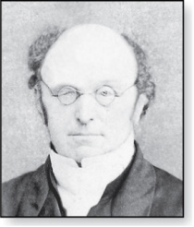
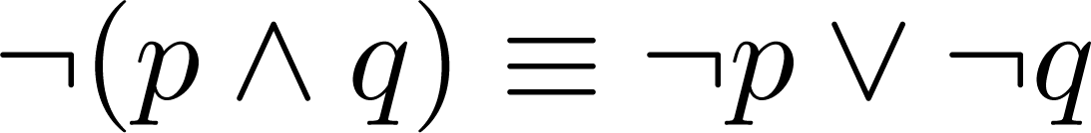
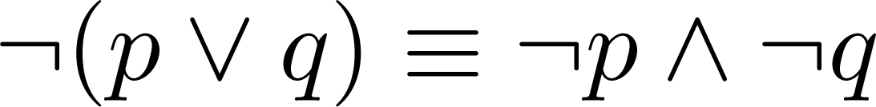
De Morgan’s Laws
Augustus De Morgan
1806-1871
This truth table shows that De Morgan’s Second Law holds.
p | q | ¬p | ¬q | (p∨q) | ¬(p∨q) | ¬p∧¬q
T | T | F | F | T | F | F
T | F | F | T | T | F | F
F | T | T | F | T | F | F
F | F | T | T | F | T | T

Slide 47
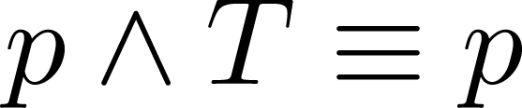
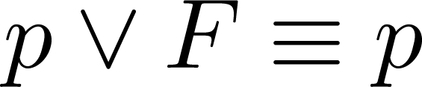
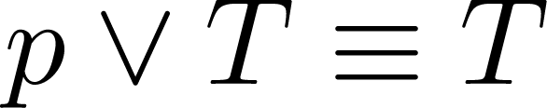
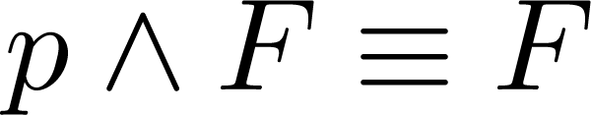
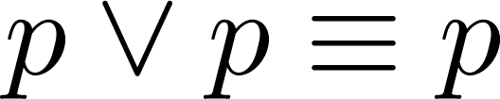
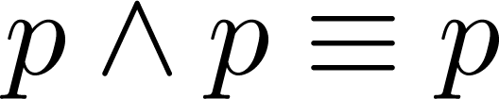
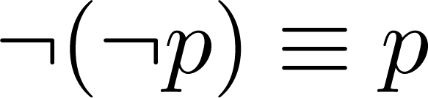
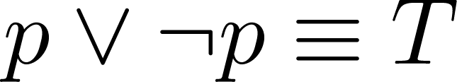
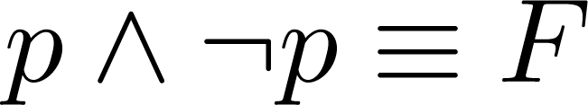
Key Logical Equivalences
Identity Laws: ,
Domination Laws: ,
Idempotent laws: ,
Double Negation Law:
Negation Laws: ,

Slide 48
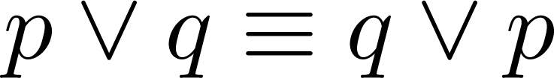
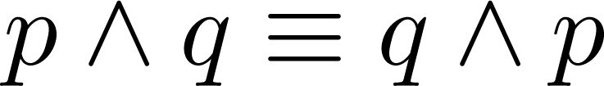
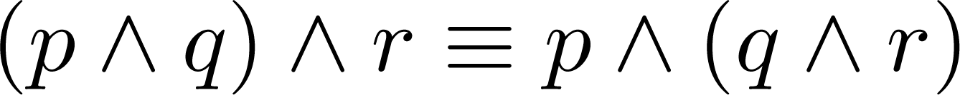
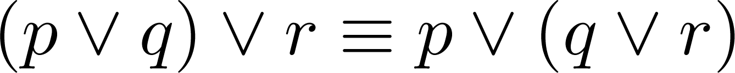
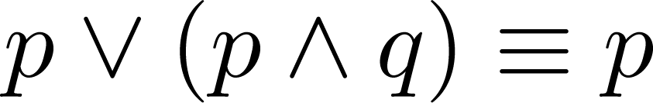
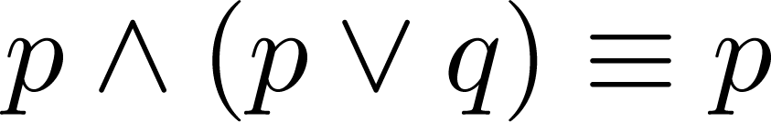
Key Logical Equivalences (cont)
Commutative Laws: ,
Associative Laws:
Distributive Laws:
Absorption Laws:

Slide 49
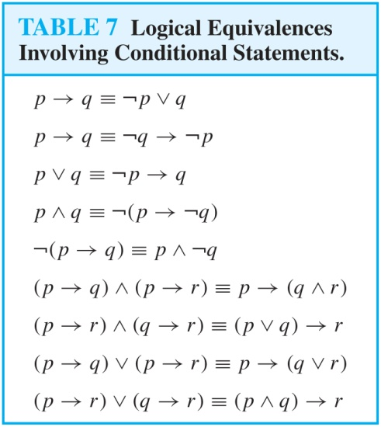
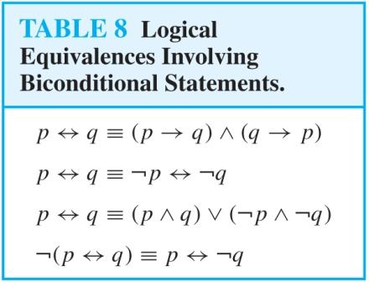
More Logical Equivalences

Slide 50

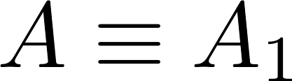
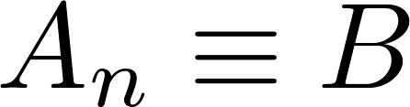
Constructing New Logical Equivalences
We can show that two expressions are logically equivalent by developing a series of logically equivalent statements.
To prove that we produce a series of equivalences beginning with A and ending with B.
Keep in mind that whenever a proposition (represented by a propositional variable) occurs in the equivalences listed earlier, it may be replaced by an arbitrarily complex compound proposition.

Slide 51
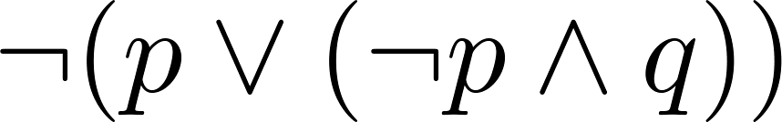
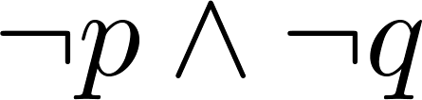
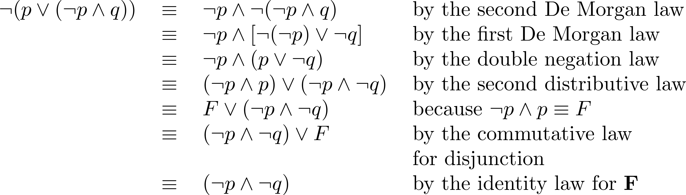
Equivalence Proofs
Example: Show that
is logically equivalent to
Solution:

Slide 52
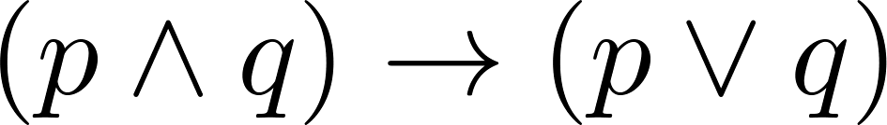
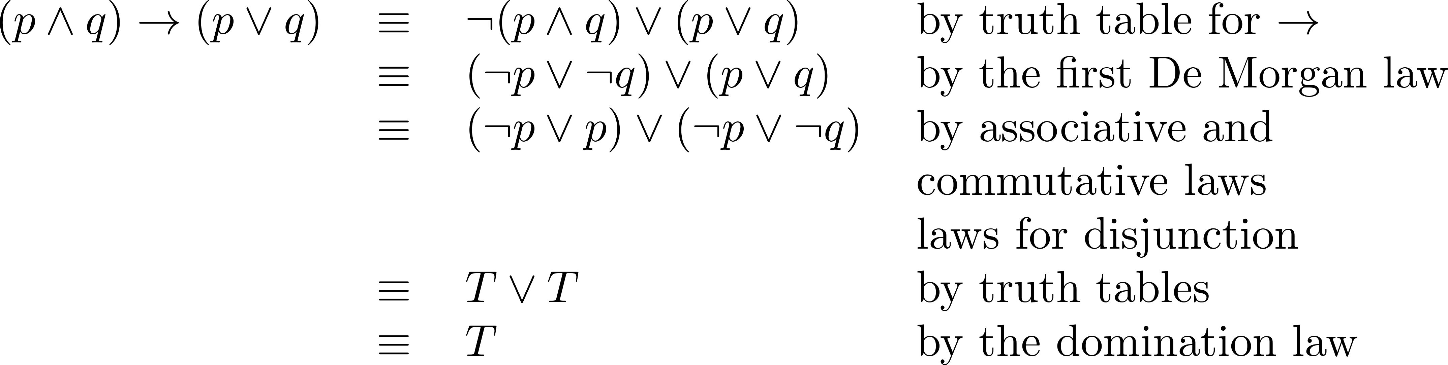
Equivalence Proofs
Example: Show that
is a tautology.
Solution:

Slide 53
Dual (p.35 below 33)
The dual of compound proposition that contains only the logical operators ∨ , ∧ and ¬ is the proposition obtained by replacing each ∨ by ∧,each ∧ by ∨,each T by F and each F by T. the dual of S is denoted by S*.
S=(p ∨ ¬ q) ∧r ∨ T S*= (p ∧ ¬ q) ∨ r ∧ F

Slide 54
Dual (cont…)
S= (p ∧ q) → (p ∨ q) = ¬(p ∧ q) ∨ (p ∨ q)
S*= ¬(p ∨ q) ∧ (p ∧ q)
Theorem: let s and t are two compound propositions, s ⇔ t if and only if s* ⇔ t*

Slide 55
Functionally complete operators
A collection of logical operators is called functionally complete if every compound proposition is logically equivalent to a compound proposition involving only these logical operators.
{¬, ∧ } ,{¬, ∧} ,{|} ,{↓} are all functionally complete operators.

Slide 56
Propositional Satisfiability
A compound proposition is satisfiable if there is an assignment of truth values to its variables that make it true. When no such assignments exist, the compound proposition is unsatisfiable.
A compound proposition is unsatisfiable if and only if it is a contradiction or its negation is a tautology.

Slide 57
Questions on Propositional Satisfiability
Example: Determine the satisfiability of the following compound propositions:
Solution: Satisfiable. Assign T to p, q, and r.
Solution: Satisfiable. Assign T to p and F to q.
Solution: Not satisfiable. Check each possible assignment of truth values to the propositional variables and none will make the proposition true.

Slide 58
Notation
Needed for the next example.

Slide 59
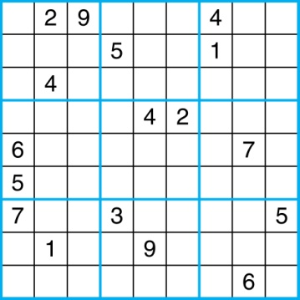
Sudoku
A Sudoku puzzle is represented by a 9×9 grid made up of nine 3×3 subgrids, known as blocks. Some of the 81 cells of the puzzle are assigned one of the numbers 1,2, …, 9.
The puzzle is solved by assigning numbers to each blank cell so that every row, column and block contains each of the nine possible numbers.
Example

Slide 60
求解结果

Slide 61
Encoding as a Satisfiability Problem
Let p(i,j,n) denote the proposition that is true when the number n is in the cell in the ith row and the jth column.
There are 9×9 × 9 = 729 such propositions.
In the sample puzzle p(5,1,6) is true, but p(5,j,6) is false for j = 2,3,…9

Slide 62
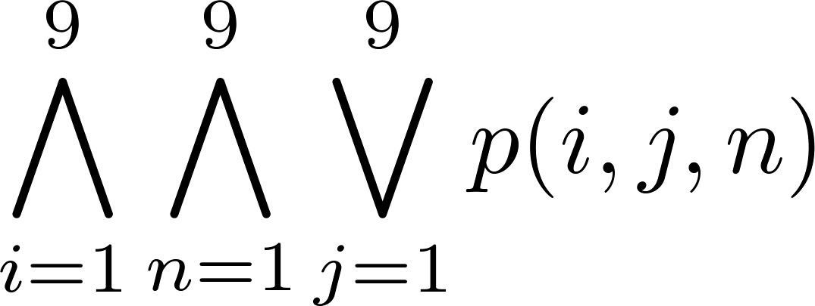
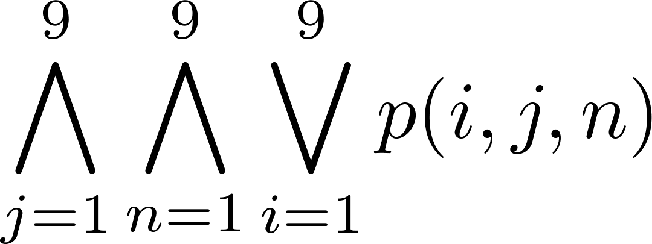
Encoding (cont)
For each cell with a given value, assert p(d,j,n), when the cell in row i and column j has the given value.
Assert that every row contains every number.
Assert that every column contains every number.

Slide 63
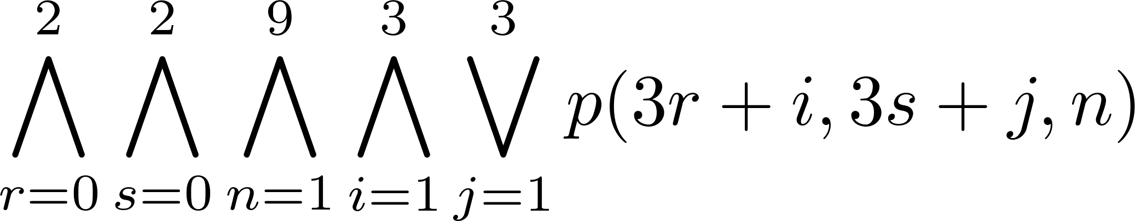
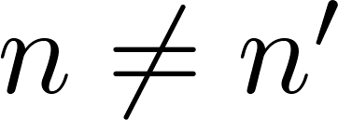
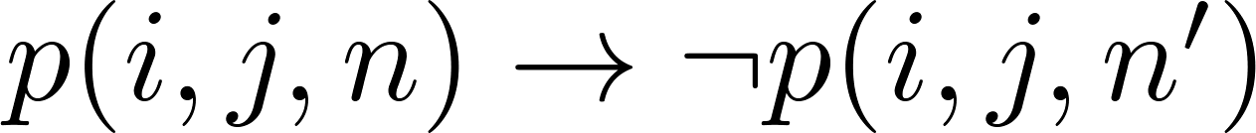
Encoding (cont)
Assert that each of the 3 x 3 blocks contain every number.
(this is tricky - ideas from chapter 4 help)
Assert that no cell contains more than one number. Take the conjunction over all values of n, n’, i, and j, where each variable ranges from 1 to 9 and ,
of

Slide 64
Solving Satisfiability Problems
To solve a Sudoku puzzle, we need to find an assignment of truth values to the 729 variables of the form p(i,j,n) that makes the conjunction of the assertions true. Those variables that are assigned T yield a solution to the puzzle.
A truth table can always be used to determine the satisfiability of a compound proposition. But this is too complex even for modern computers for large problems.
There has been much work on developing efficient methods for solving satisfiability problems as many practical problems can be translated into satisfiability problems.

Slide 65
Exercises
7th edition
P34-36 5, 15, 53,

Slide 66
Propositional Normal Forms
Section 1.3 (supplement)

Slide 67
Propositional Formula
(1) Each propositional variable is a formula, and the truth values T and F are also formulas.
(2) If A is formula, so is (¬A).
(3) If A and B are formulas, so are (A ∨ B), (A ∧ B), (A → B), (A ↔ B).
(4) A string of symbols is a formula only as it is determined by (finitely many applications of) the above three rules.

Slide 68
Example
EXAMPLE
The following string are formulas:
¬(p ∨ q), p → (q → r), (p ∧ q) → r
The following string are not formulas:
pq →r, ¬p→q) → r

Slide 69
Propositional Normal Forms
Formulas can be transformed into standard forms so that they become more convenient for symbolic manipulations and make identification and comparison of two formulas easier.

Slide 70
Normal Forms
There are two types of normal forms in propositional calculus:
the disjunctive normal form(DNF)
and
the conjunctive normal form(CNF).
DEFINITION. A literal is a variable or its negation
Example p and ¬p are literals, but p ∧q is not.

Slide 71
Propositional Normal Forms
DEFINITION. A formula is said to be in disjunctive normal form if it is written as a disjunction, in which all the terms are conjunctions of literals.
EXAMPLE 1 (p ∧ q) ∨(p ∧ ¬q), p ∨ (q ∧ r), ¬p ∨T are in disjunctive normal forms. The disjunction ¬(p ∧ q) ∨ r is not in normal form. (Why?)

Slide 72
Clauses（子句）
In general a formula in disjunctive normal form is
(A₁₁ ∧ · · · ∧ A_{1n}) ∨ · · · ∨ (A_{k1} ∧ · · · ∧ A_{knk} )
DEFINITION. Disjunctions (conjunctions) with literals as disjuncts (conjuncts) are called disjunctive (conjunctive) clauses. Disjunctive and conjunctive clauses are simply called clauses.

Slide 73
Clauses (cont…)
Example: p ∧ q∧¬r is a conjunctive clause
¬p ∨ q ∨¬r is a disjunctive clause
Conjunctive clause is also called basic product and Disjunctive clause is also called basic addition.
DEFINITION. A conjunction with disjunctive clauses as its conjunctions is said to be in Conjunctive normal form.

Slide 74
Cont..
EXAMPLE 2 p ∧ (q ∨ r) and p ∧ F are in conjunctive normal form.
However p ∧ (r ∨ (p ∧ q)) is not in conjunctive form.
In general a formula in conjunctive normal form is
(A₁₁ ∨ · · · ∨ A_{1n}) ∧ · · · ∧ (A_{k1} ∨ · · · ∨ A_{knk} )

Slide 75
Conjunctive normal form
Observe the following formulas:
p
¬p ∨ q
¬p ∧ q ∧ ¬r
(4) ¬p ∨ (q ∧ ¬r)
(5) ¬p ∧ (q ∨ ¬r) ∧ (¬q ∨ r)
(1),(2),(3),(5) are in conjunctive normal forms. (1),(2),(3),(4) are in disjunctive normal forms

Slide 76
How to obtain normal forms
Eliminating → , ↔,|, ↓
Eliminating ¬, ∨ , ∧ from the scope of ¬, such that any ¬ has only an atom as its scope. In other words eliminating the parenthesis following behind ¬
This method leads to obtaining the disjunctive or conjunctive normal forms.

Slide 77
Example
Convert the following formula into a conjunctive normal form.
¬((p ∨ ¬q) ∧ ¬r)
The conjunctive normal form can be found by the following derivations:
¬((p ∨ ¬q) ∧ ¬r)
(1) ¬(p ∨ ¬q) ∨ ¬¬r) De Morgan
(2) ¬(p ∨ ¬q) ∨ r Double negation

Slide 78
Example
(3) (¬p ∧ ¬¬q) ∨ r De Morgan
(4) (¬p ∧ q) ∨ r Double negation
(5) (¬p ∨ r) ∧ (q ∨ r) Distributivity
EXAMPLE 5 Convert the following formula into a conjunctive normal form.
(p1 ∧ p2) ∨ (p3) ∧ (p4 ∨ p5)

Slide 79
Example
Solution:
(p1 ∧ p2) ∨ (p3) ∧ (p4 ∨ p5) ⇔
(p1 ∧ p2) ∨ (p3∧ (p4 ∨ p5)) ⇔
((p1 ∧ p2) ∨ p3) ∧ ((p1 ∧ p2) ∨ (p4 ∨ p5))
⇔(p1 ∨ p3) ∧ (p1 ∨ p4 ∨ p5) ∧ (p2 ∨ p3) ∧ (p2 ∨ p4 ∨ p5)

Slide 80
Disjunctive normal forms from truth tables
So far we have shown how to find the truth table of a logical formula. The reverse is also possible. One can convert any given truth table into a formula.
The formula obtained in this way is already in disjunctive normal form.
In fact, the conceptually easiest method to find the normal form of a formula is by using truth tables. Unfortunately, truth tables grow exponentially with the number of variables,

Slide 81
Disjunctive normal forms from truth tables
which makes this method unattractive for formulas with many variables.
Generally, a truth table gives truth values of some formula for all possible assignments. The table below gives an example of truth table for a certain formula f. The truth values of f depends on the three variables p, q, r.
This makes f a truth function, or a Boolean function with arguments

Slide 82
(cont…)
p q r f
T T T T
T T F F
T F T T
T F F F
F T T F
F T F F
F F T T
F F F F

Slide 83
minterm
To convert a Boolean function into a formula, one makes use of minterms.
DEFINITION. A minterm is a conjunction of literals in which each variable is represented exactly once.
EXAMPLE 7 If a Boolean function has the variables p, q, r then p ^¬q ^ r is a minterm but p ^ ¬q and p ^ p ^ ¬q are not.

Slide 84
Representation of minterm
There are 2^{n} different minterm for n propositional variables. For example there 4 different minterm for p, q, they are p^q, p^¬q, ¬p ^q, ¬p^¬q. For the sake of simplification, we use m_{j} denote the minterms. Where j is a integer, its binary representation corresponds the evaluation of variables that make m_{j} be equal to T.

Slide 85
Example
For three propositional variables,
m₀ = ¬p^¬q^¬r m₁ = ¬p^¬q^r
m₂ = ¬p^q^¬r m₃ = ¬p^q^r
m₄ = p^¬q^¬r m₅ = p^¬q^r
m₆ = p^q^¬r m₇ = p^q^r
If a propositional form is denoted by: f= m_{j} ∨ m_{k} ∨… ∨ m_{l} we simply denote
f=∑m(j,k,..,l)

Slide 86
Properties of minterms
(1) Each minterm is true for exactly one assignment. For example, p^¬q^r is true if p is T, q is F and r is T. Any deviation from this assignment would make this particular minterm false.
(2) The conjunction of two different minterm is always false. I.e. m_{i}^ m_{k}=F
(3) The disjunction of all mintern is T
m₀ ∨m₁ ∨… ∨ m₂n₋₁ =T

Slide 87
Properties of minterms
A disjunction of minterms is true only if at least one of its constituents minterms is true. For example,
(p^q^r)∨(p^¬q^r)∨(¬p^¬q^r)
is only true if at least one of p^q^r,
p^¬q^r or ¬p^¬q^r is true.

Slide 88
Minterms and truth tables
If a function, such as f, is given by truth table, we know exactly for which assignments it is true. Consequently, we can select the minterms that make the function true and form the disjunction of these minterms.
The function f, for instance, is true for three assignments:

Slide 89
Disjunctive normal forms from truth tables
1. p, q, r are all true.
2. p,¬q, r are all true.
3. ¬p,¬q, r are all true.
The disjunction of the corresponding minterms is tautologically equivalent to f, which means that we have the following formula for f:
f ⇔(p^q^r)∨(p^¬q^r)∨(¬p^¬q^r)

Slide 90
Full disjunctive form
Actually, we have a special type of normal form, the full disjunctive form.
DEFINITION. If a Boolean function is expressed as a disjunction of minterms, it is said to be in full disjunctive form.

Slide 91
How to find Full disjunctive form
Two methods:
(1) From truth table;
(2) From disjunctive form, changing its clauses to minterms.
Example finding the From disjunctive form of formula
f = (p^¬q) → (¬r^¬p)

Slide 92
Solution
p q r p^¬q ¬r^¬p (p^¬q)→ (¬r^¬p)
F F F F T T
F F T F F T
F T F F T T
F T T F F T
T F F T F F
T F T T F F
T T F F F T
T T T F F T

Slide 93
Cont..
So f = ∑m(0,1,2,3,6,7)
Solution 2:
f = (p^¬q) → (¬r^¬p)
= ¬(p^¬q) ∨ (¬r^¬p)
= ¬p ∨ q ∨ (¬r^¬p)
= (¬p^T^T) ∨ (q^T^T) ∨ (¬r^¬p)^T

Slide 94
Cont..
= (¬p^(q∨¬q) ^ (r∨¬r) )
∨ (q^(p∨¬ p)^(r∨¬r))
∨ (¬r^¬p)^ (r∨¬r)
= (¬p^¬q^¬r)∨(¬p^¬q^r)∨(¬p^q^¬r)∨
(¬p^q^r)∨ (p^q^ ¬r)∨ (¬p^¬q^¬r)
= m₀ ∨ m₁ ∨ m₂ ∨ m₃ ∨ m₆ ∨ m₇

Slide 95
Conjunctive Normal Form
A compound proposition is in Conjunctive Normal Form (CNF) if it is a conjunction of disjunctions.
Every proposition can be put in an equivalent CNF.
Conjunctive Normal Form (CNF) can be obtained by eliminating implications, moving negation inwards and using the distributive and associative laws.
Important in resolution theorem proving used in artificial Intelligence (AI).
A compound proposition can be put in conjunctive normal form through repeated application of the logical equivalences covered earlier.

Slide 96
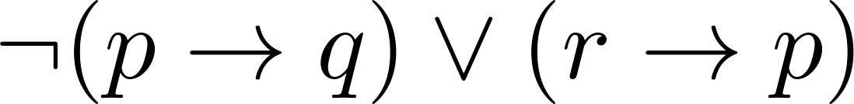
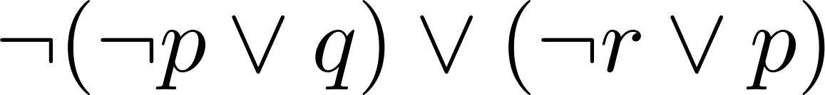
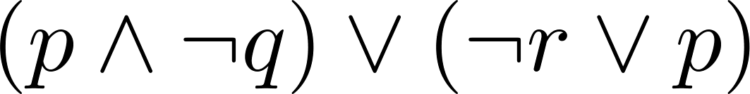
Conjunctive Normal Form (optional)
Example: Put the following into CNF:
Solution:
Eliminate implication signs:
Move negation inwards; eliminate double negation:
Convert to CNF using associative/distributive laws

Slide 97
Conjunctive Normal Form and Disjunctive form
We can convert disjunctive form to Conjunctive Normal Form directly
Let f = ∑m(j,k,..,l), g = ∑m({0,1,2,….2^{n-1}}-{j,k,..,l})
Then f ∨g = T, f^g = F, hence
f = ¬g = π M({0,1,2,….2^{n-1}}-{j,k,..,l})
Where M_{i} = is ¬ m_{i} is a disjunction.

Slide 98
Exercise
7th edition
P34-36 57
Find the full disjunctive form from truth table of following formula
((¬p ^ q) → (p ↔r)) ∨(q → ¬r)

Slide 99
Predicates and Quantifiers
Section 1.4

Slide 100
Section Summary
Predicates
Variables
Quantifiers
Universal Quantifier
Existential Quantifier
Negating Quantifiers
De Morgan’s Laws for Quantifiers
Translating English to Logic
Logic Programming (optional)

Slide 101
Propositional Logic Not Enough
If we have:
“All men are mortal.”
“Socrates is a man.”
Does it follow that “Socrates is mortal?”
Can’t be represented in propositional logic. Need a language that talks about objects, their properties, and their relations.
Later we’ll see how to draw inferences.

Slide 102
Introducing Predicate Logic
Predicate logic uses the following new features:
Variables: x, y, z
Predicates: P(x), M(x)
Quantifiers (to be covered in a few slides):
Propositional functions are a generalization of propositions.
They contain variables and a predicate, e.g., P(x)
Variables can be replaced by elements from their domain.

Slide 103
Propositional Functions
Propositional functions become propositions (and have truth values) when their variables are each replaced by a value from the domain (or bound by a quantifier, as we will see later).
The statement P(x) is said to be the value of the propositional function P at x.
For example, let P(x) denote “x > 0” and the domain be the integers. Then:
P(-3) is false.
P(0) is false.
P(3) is true.
Often the domain is denoted by U. So in this example U is the integers.

Slide 104
Examples of Propositional Functions
Let “x + y = z” be denoted by R(x, y, z) and U (for all three variables) be the integers. Find these truth values:
R(2,-1,5)
Solution: F
R(3,4,7)
Solution: T
R(x, 3, z)
Solution: Not a Proposition
Now let “x - y = z” be denoted by Q(x, y, z), with U as the integers. Find these truth values:
Q(2,-1,3)
Solution: T
Q(3,4,7)
Solution: F
Q(x, 3, z)
Solution: Not a Proposition

Slide 105
Compound Expressions
Connectives from propositional logic carry over to predicate logic.
If P(x) denotes “x > 0,” find these truth values:
P(3) ∨ P(-1) Solution: T
P(3) ∧ P(-1) Solution: F
P(3) → P(-1) Solution: F
P(3) → P(-1) Solution: T
Expressions with variables are not propositions and therefore do not have truth values. For example,
P(3) ∧ P(y)
P(x) → P(y)
When used with quantifiers (to be introduced next), these expressions (propositional functions) become propositions.

Slide 106
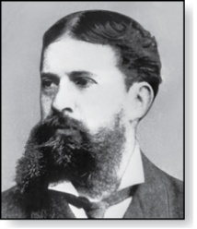
Quantifiers
Charles Peirce (1839-1914)
We need quantifiers to express the meaning of English words including all and some:
“All men are Mortal.”
“Some cats do not have fur.”
The two most important quantifiers are:
Universal Quantifier, “For all,” symbol: ∀
Existential Quantifier, “There exists,” symbol: ∃
We write as in ∀x P(x) and ∃x P(x).
∀x P(x) asserts P(x) is true for every x in the domain.
∃x P(x) asserts P(x) is true for some x in the domain.
The quantifiers are said to bind the variable x in these expressions.

Slide 107
Universal Quantifier
∀x P(x) is read as “For all x, P(x)” or “For every x, P(x)”
Examples:
If P(x) denotes “x > 0” and U is the integers, then ∀x P(x) is false.
If P(x) denotes “x > 0” and U is the positive integers, then ∀x P(x) is true.
If P(x) denotes “x is even” and U is the integers, then ∀ x P(x) is false.

Slide 108
Existential Quantifier
∃x P(x) is read as “For some x, P(x)”, or as “There is an x such that P(x),” or “For at least one x, P(x).”
Examples:
If P(x) denotes “x > 0” and U is the integers, then ∃x P(x) is true. It is also true if U is the positive integers.
If P(x) denotes “x < 0” and U is the positive integers, then ∃x P(x) is false.
If P(x) denotes “x is even” and U is the integers, then ∃x P(x) is true.

Slide 109
Uniqueness Quantifier (optional)
∃!x P(x) means that P(x) is true for one and only one x in the universe of discourse.
This is commonly expressed in English in the following equivalent ways:
“There is a unique x such that P(x).”
“There is one and only one x such that P(x)”
Examples:
If P(x) denotes “x + 1 = 0” and U is the integers, then ∃!x P(x) is true.
But if P(x) denotes “x > 0,” then ∃!x P(x) is false.
The uniqueness quantifier is not really needed as the restriction that there is a unique x such that P(x) can be expressed as:
∃x (P(x) ∧∀y (P(y) → y =x))

Slide 110
Thinking about Quantifiers
When the domain of discourse is finite, we can think of quantification as looping through the elements of the domain.
To evaluate ∀x P(x) loop through all x in the domain.
If at every step P(x) is true, then ∀x P(x) is true.
If at a step P(x) is false, then ∀x P(x) is false and the loop terminates.
To evaluate ∃x P(x) loop through all x in the domain.
If at some step, P(x) is true, then ∃x P(x) is true and the loop terminates.
If the loop ends without finding an x for which P(x) is true, then ∃x P(x) is false.
Even if the domains are infinite, we can still think of the quantifiers this fashion, but the loops will not terminate in some cases.

Slide 111
Properties of Quantifiers
The truth value of ∃x P(x) and ∀ x P(x) depend on both the propositional function P(x) and on the domain U.
Examples:
If U is the positive integers and P(x) is the statement “x < 2”, then ∃x P(x) is true, but ∀ x P(x) is false.
If U is the negative integers and P(x) is the statement “x < 2”, then both ∃x P(x) and ∀ x P(x) are true.
If U consists of 3, 4, and 5, and P(x) is the statement “x > 2”, then both ∃x P(x) and ∀ x P(x) are true. But if P(x) is the statement “x < 2”, then both ∃x P(x) and ∀ x P(x) are false.

Slide 112
Precedence of Quantifiers
The quantifiers ∀ and ∃ have higher precedence than all the logical operators.
For example, ∀x P(x) ∨ Q(x) means (∀x P(x))∨ Q(x)
∀x (P(x) ∨ Q(x)) means something different.
Unfortunately, often people write ∀x P(x) ∨ Q(x) when they mean ∀ x (P(x) ∨ Q(x)).

Slide 113
Translating from English to Logic
Example 1: Translate the following sentence into predicate logic: “Every student in this class has taken a course in Java.”
Solution:
First decide on the domain U.
Solution 1: If U is all students in this class, define a propositional function J(x) denoting “x has taken a course in Java” and translate as ∀x J(x).
Solution 2: But if U is all people, also define a propositional function S(x) denoting “x is a student in this class” and translate as ∀x (S(x)→ J(x)).
∀x (S(x) ∧ J(x)) is not correct. What does it mean?

Slide 114
Translating from English to Logic
Example 2: Translate the following sentence into predicate logic: “Some student in this class has taken a course in Java.”
Solution:
First decide on the domain U.
Solution 1: If U is all students in this class, translate as
∃x J(x)
Solution 1: But if U is all people, then translate as ∃x (S(x) ∧ J(x))
∃x (S(x)→ J(x)) is not correct. What does it mean?

Slide 115
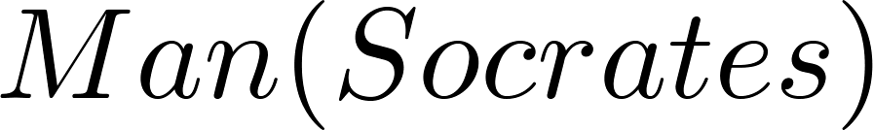
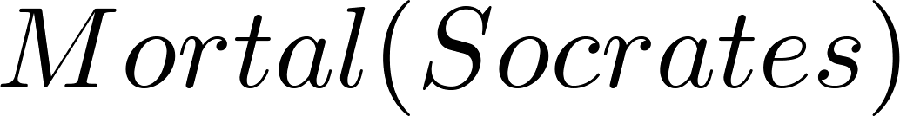
Returning to the Socrates Example
Introduce the propositional functions Man(x) denoting “x is a man” and Mortal(x) denoting “x is mortal.” Specify the domain as all people.
The two premises are:
The conclusion is:
Later we will show how to prove that the conclusion follows from the premises.

Slide 116
Equivalences in Predicate Logic
Statements involving predicates and quantifiers are logically equivalent if and only if they have the same truth value
for every predicate substituted into these statements and
for every domain of discourse used for the variables in the expressions.
The notation S ≡T indicates that S and T are logically equivalent.
Example: ∀x ¬¬S(x) ≡ ∀x S(x)

Slide 117
Thinking about Quantifiers as Conjunctions and Disjunctions
If the domain is finite, a universally quantified proposition is equivalent to a conjunction of propositions without quantifiers and an existentially quantified proposition is equivalent to a disjunction of propositions without quantifiers.
If U consists of the integers 1,2, and 3:
Even if the domains are infinite, you can still think of the quantifiers in this fashion, but the equivalent expressions without quantifiers will be infinitely long.

Slide 118
Negating Quantified Expressions
Consider ∀x J(x)
“Every student in your class has taken a course in Java.”
Here J(x) is “x has taken a course in calculus” and
the domain is students in your class.
Negating the original statement gives “It is not the case that every student in your class has taken Java.” This implies that “There is a student in your class who has not taken calculus.”
Symbolically ¬∀x J(x) and ∃x ¬J(x) are equivalent

Slide 119
Negating Quantified Expressions (continued)
Now Consider ∃ x J(x)
“There is a student in this class who has taken a course in Java.”
Where J(x) is “x has taken a course in Java.”
Negating the original statement gives “It is not the case that there is a student in this class who has taken Java.” This implies that “Every student in this class has not taken Java”
Symbolically ¬∃ x J(x) and ∀ x ¬J(x) are equivalent

Slide 120
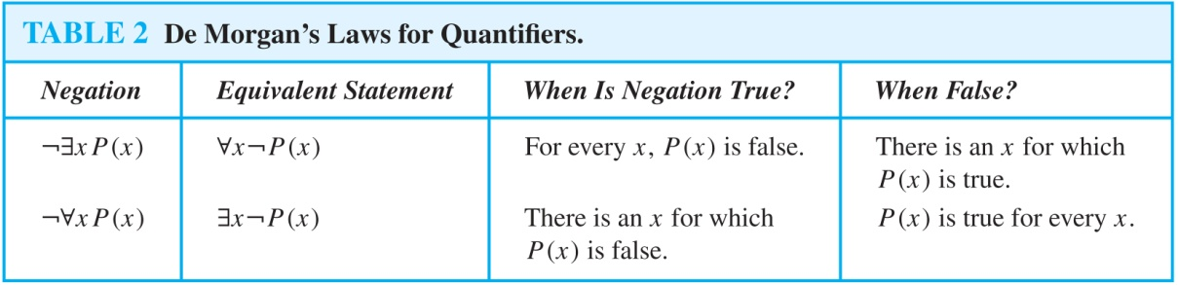
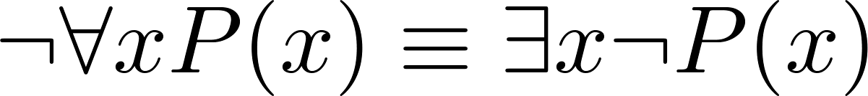
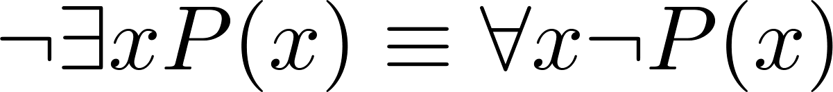
De Morgan’s Laws for Quantifiers
The rules for negating quantifiers are:
The reasoning in the table shows that:
These are important. You will use these.

Slide 121
Translation from English to Logic
Examples:
“Some student in this class has visited Mexico.”
Solution: Let M(x) denote “x has visited Mexico” and S(x) denote “x is a student in this class,” and U be all people.
∃x (S(x) ∧ M(x))
“Every student in this class has visited Canada or Mexico.”
Solution: Add C(x) denoting “x has visited Canada.”
∀x (S(x)→ (M(x)∨C(x)))

Slide 122
Some Fun with Translating from English into Logical Expressions
U = {fleegles, snurds, thingamabobs}
F(x): x is a fleegle
S(x): x is a snurd
T(x): x is a thingamabob
Translate “Everything is a fleegle”
Solution: ∀x F(x)

Slide 123
Translation (cont)
U = {fleegles, snurds, thingamabobs}
F(x): x is a fleegle
S(x): x is a snurd
T(x): x is a thingamabob
“Nothing is a snurd.”
Solution: ¬∃x S(x) What is this equivalent to?
Solution: ∀x ¬ S(x)

Slide 124
Translation (cont)
U = {fleegles, snurds, thingamabobs}
F(x): x is a fleegle
S(x): x is a snurd
T(x): x is a thingamabob
“All fleegles are snurds.”
Solution: ∀x (F(x)→ S(x))

Slide 125
Translation (cont)
U = {fleegles, snurds, thingamabobs}
F(x): x is a fleegle
S(x): x is a snurd
T(x): x is a thingamabob
“Some fleegles are thingamabobs.”
Solution: ∃x (F(x) ∧ T(x))

Slide 126
Translation (cont)
U = {fleegles, snurds, thingamabobs}
F(x): x is a fleegle
S(x): x is a snurd
T(x): x is a thingamabob
“No snurd is a thingamabob.”
Solution: ¬∃x (S(x) ∧ T(x)) What is this equivalent to?
Solution: ∀x (¬S(x) ∨ ¬T(x))

Slide 127
Translation (cont)
U = {fleegles, snurds, thingamabobs}
F(x): x is a fleegle
S(x): x is a snurd
T(x): x is a thingamabob
“If any fleegle is a snurd then it is also a thingamabob.”
Solution: ∀x ((F(x) ∧ S(x))→ T(x))

Slide 128
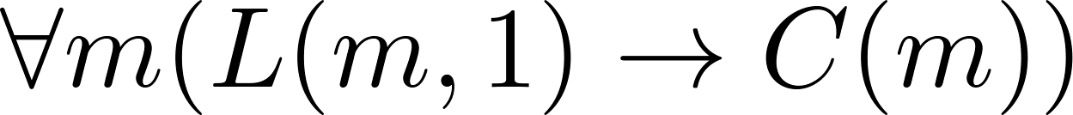
System Specification Example
Predicate logic is used for specifying properties that systems must satisfy.
For example, translate into predicate logic:
“Every mail message larger than one megabyte will be compressed.”
“If a user is active, at least one network link will be available.”
Decide on predicates and domains (left implicit here) for the variables:
Let L(m, y) be “Mail message m is larger than y megabytes.”
Let C(m) denote “Mail message m will be compressed.”
Let A(u) represent “User u is active.”
Let S(n, x) represent “Network link n is state x.
Now we have:

Slide 129
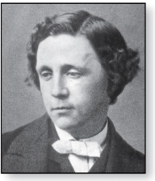
Lewis Carroll Example
Charles Lutwidge Dodgson
(AKA Lewis Caroll)
(1832-1898)
The first two are called premises and the third is called the conclusion.
“All lions are fierce.”
“Some lions do not drink coffee.”
“Some fierce creatures do not drink coffee.”
Here is one way to translate these statements to predicate logic. Let P(x), Q(x), and R(x) be the propositional functions “x is a lion,” “x is fierce,” and “x drinks coffee,” respectively.
∀x (P(x)→ Q(x))
∃x (P(x) ∧ ¬R(x))
∃x (Q(x) ∧ ¬R(x))
Later we will see how to prove that the conclusion follows from the premises.

Slide 130
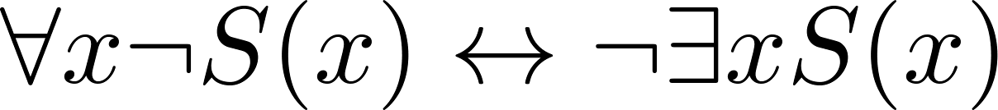
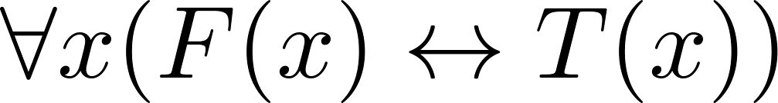

Some Predicate Calculus Definitions (optional)
An assertion involving predicates and quantifiers is valid if it is true
for all domains
every propositional function substituted for the predicates in the assertion.
Example:
An assertion involving predicates is satisfiable if it is true
for some domains
some propositional functions that can be substituted for the predicates in the assertion.
Otherwise it is unsatisfiable.
Example: not valid but satisfiable
Example: unsatisfiable

Slide 131


MorePredicate Calculus Definitions (optional)
The scope of a quantifier is the part of an assertion in which variables are bound by the quantifier.
Example: x has wide scope
Example: x has narrow scope

Slide 132
Logic Programming (optional)
Prolog (from Programming in Logic) is a programming language developed in the 1970s by researchers in artificial intelligence (AI).
Prolog programs include Prolog facts and Prolog rules.
As an example of a set of Prolog facts consider the following:
instructor(chan, math273).
instructor(patel, ee222).
instructor(grossman, cs301).
enrolled(kevin, math273).
enrolled(juna, ee222).
enrolled(juana, cs301).
enrolled(kiko, math273).
enrolled(kiko, cs301).
Here the predicates instructor(p,c) and enrolled(s,c) represent that professor p is the instructor of course c and that student s is enrolled in course c.

Slide 133
Logic Programming (cont)
In Prolog, names beginning with an uppercase letter are variables.
If we have apredicate teaches(p,s) representing “professor p teaches student s,” we can write the rule:
teaches(P,S) :- instructor(P,C), enrolled(S,C).
This Prolog rule can be viewed as equivalent to the following statement in logic (using our conventions for logical statements).
∀p ∀c ∀s(I(p,c) ∧ E(s,c)) → T(p,s))

Slide 134
Logic Programming (cont)
Prolog programs are loaded into a Prolog interpreter. The interpreter receives queries and returns answers using the Prolog program.
For example, using our program, the following query may be given:
?enrolled(kevin,math273).
Prolog produces the response:
yes
Note that the ? is the prompt given by the Prolog interpreter indicating that it is ready to receive a query.

Slide 135
Logic Programming (cont)
The query:
?enrolled(X,math273).
produces the response:
X = kevin;
X = kiko;
no
The query:
?teaches(X,juana).
produces the response:
X = patel;
X = grossman;
no
The Prolog interpreter tries to find an instantiation for X. It does so and returns X = kevin. Then the user types the ; indicating a request for another answer. When Prolog is unable to find another answer it returns no.

Slide 136
Logic Programming (cont)
The query:
?teaches(chan,X).
produces the response:
X = kevin;
X = kiko;
no
A number of very good Prolog texts are available. Learn Prolog Now! is one such text with a free online version at http://www.learnprolognow.org/
There is much more to Prolog and to the entire field of logic programming.

Slide 137
Exercise
7th edition
P53-56 7, 25, 35

Slide 138
Nested Quantifiers
Section 1.5

Slide 139
Section Summary
Nested Quantifiers
Order of Quantifiers
Translating from Nested Quantifiers into English
Translating Mathematical Statements into Statements involving Nested Quantifiers.
Translated English Sentences into Logical Expressions.
Negating Nested Quantifiers.

Slide 140
Nested Quantifiers
Nested quantifiers are often necessary to express the meaning of sentences in English as well as important concepts in computer science and mathematics.
Example: “Every real number has an inverse” is
∀x ∃y(x + y = 0)
where the domains of x and y are the real numbers.
We can also think of nested propositional functions:
∀x ∃y(x + y = 0) can be viewed as ∀x Q(x) where Q(x) is ∃y P(x, y) where P(x, y) is (x + y = 0)

Slide 141
Thinking of Nested Quantification
Nested Loops
To see if ∀x∀yP (x,y) is true, loop through the values of x :
At each step, loop through the values for y.
If for some pair of x andy, P(x,y) is false, then ∀x ∀yP(x,y) is false and both the outer and inner loop terminate.
∀x ∀y P(x,y) is true if the outer loop ends after stepping through each x.
To see if ∀x ∃yP(x,y) is true, loop through the values of x:
At each step, loop through the values for y.
The inner loop ends when a pair x and y is found such that P(x, y) is true.
If no y is found such that P(x, y) is true the outer loop terminates as ∀x ∃yP(x,y) has been shown to be false.
∀x ∃y P(x,y) is true if the outer loop ends after stepping through each x.
If the domains of the variables are infinite, then this process can not actually be carried out.

Slide 142
Order of Quantifiers
Examples:
Let P(x,y) be the statement “x + y = y + x.” Assume that U is the real numbers. Then ∀x ∀yP(x,y) and ∀y ∀xP(x,y) have the same truth value.
Let Q(x,y) be the statement “x + y = 0.” Assume that U is the real numbers. Then ∀x ∃yP(x,y) is true, but ∃y ∀xP(x,y) is false.

Slide 143
Questions on Order of Quantifiers
Example 1: Let U be the real numbers,
Define P(x,y) : x ∙ y = 0
What is the truth value of the following:
∀x∀yP(x,y)
Answer: False
∀x∃yP(x,y)
Answer: True
∃x∀y P(x,y)
Answer: True
∃x ∃ y P(x,y)
Answer: True

Slide 144
Questions on Order of Quantifiers
Example 2: Let U be the real numbers,
Define P(x,y) : x / y = 1
What is the truth value of the following:
∀x∀yP(x,y)
Answer: False
∀x∃yP(x,y)
Answer: True
∃x∀y P(x,y)
Answer: False
∃x ∃ y P(x,y)
Answer: True

Slide 145






Quantifications of Two Variables
Statement | When True? | When False
 | P(x,y) is true for every pair x,y. | There is a pair x, y for which P(x,y) is false.
 | For every x there is a y for which P(x,y) is true. | There is an x such that P(x,y) is false for every y.
 | There is an x for which P(x,y) is true for every y. | For every x there is a y for which P(x,y) is false.
 | There is a pair x, y for which P(x,y) is true. | P(x,y) is false for every pair x,y

Slide 146
Translating Nested Quantifiers into English
Example 9: Translate the statement
∀x (C(x )∨ ∃y (C(y ) ∧ F(x, y)))
where C(x) is “x has a computer,” and F(x,y) is “x and y are friends,” and the domain for both x and y consists of all students in your school.
Solution: Every student in your school has a computer or has a friend who has a computer.
Example 10: Translate the statement
∃x∀y ∀z ((F(x, y)∧ F(x,z) ∧ (y ≠z))→¬F(y,z))
Solution: Every student none of whose friends are also friends with each other.

Slide 147
Translating Mathematical Statements into Predicate Logic
Example : Translate “The sum of two positive integers is always positive” into a logical expression.
Solution:
Rewrite the statement to make the implied quantifiers and domains explicit:
“For every two integers, if these integers are both positive, then the sum of these integers is positive.”
Introduce the variables x and y, and specify the domain, to obtain:
“For all positive integers x and y, x + y is positive.”
The result is:
∀x ∀ y ((x > 0)∧ (y > 0)→ (x + y > 0))
where the domain of both variables consists of all integers

Slide 148
Translating English into Logical Expressions
Example 13: Use quantifiers to express the statement “There is a woman who has taken a flight on every airline in the world.”
Solution:
Let P(w,f) be “w has taken f ” and Q(f,a) be “f is a flight on a .”
The domain of w is all women, the domain of f is all flights, and the domain of a is all airlines.
Then the statement can be expressed as:
∃w ∀a ∃f (P(w,f ) ∧ Q(f,a))

Slide 149

Calculus in Logic (optional)
Example: Use quantifiers to express the definition of the limit of a real-valued function f(x) of a real variable x at a point a in its domain.
Solution: Recall the definition of the statement
is “For every real number ε > 0, there exists a real number δ > 0 such that |f(x) – L| < ε whenever 0 < |x –a| < δ.”
Using quantifiers:
Where the domain for the variables ε and δ consists of all positive real numbers and the domain for x consists of all real numbers.

Slide 150
Questions on Translation from English to Logical Expressions
Choose the obvious predicates and express in predicate logic.
Example 1: “Brothers are siblings.”
Solution: ∀x ∀y (B(x,y) → S(x,y))
Example 2: “Siblinghood is symmetric.”
Solution: ∀x ∀y (S(x,y) → S(y,x))
Example 3: “Everybody loves somebody.”
Solution: ∀x ∃y L(x,y)
Example 4: “There is someone who is loved by everyone.”
Solution: ∃y ∀x L(x,y)
Example 5: “There is someone who loves someone.”
Solution: ∃x ∃y L(x,y)
Example 6: “Everyone loves himself”
Solution: ∀x L(x,x)

Slide 151
Negating Nested Quantifiers
Example 1: Recall the logical expression developed three slides back:
∃w ∀a ∃f (P(w,f ) ∧ Q(f,a))
Part 1: Use quantifiers to express the statement that “There does not exist a woman who has taken a flight on every airline in the world.”
Solution: ¬∃w ∀a ∃f (P(w,f ) ∧ Q(f,a))
Part 2: Now use De Morgan’s Laws to move the negation as far inwards as possible.
Solution:
¬∃w ∀a ∃f (P(w,f ) ∧ Q(f,a))
∀w ¬ ∀a ∃f (P(w,f ) ∧ Q(f,a)) by De Morgan’s for ∃
∀w ∃ a ¬ ∃f (P(w,f ) ∧ Q(f,a)) by De Morgan’s for ∀
∀w ∃ a ∀f ¬ (P(w,f ) ∧ Q(f,a)) by De Morgan’s for ∃
∀w ∃ a ∀f (¬ P(w,f ) ∨ ¬ Q(f,a)) by De Morgan’s for ∧.
Part 3: Can you translate the result back into English?
Solution:
“For every woman there is an airline such that for all flights, this woman has not taken that flight or that flight is not on this airline”

Slide 152


Return to Calculus and Logic (Opt)
Example : Recall the logical expression developed in the calculus example three slides back.
Use quantifiers and predicates to express that does not exist.
We need to say that for all real numbers L,
The result from the previous example can be negated to yield:
Now we can repeatedly apply the rules for negating quantified expressions:
The last step uses the equivalence ¬(p→q) ≡ p∧¬q

Slide 153


Calculus in Predicate Logic (optional)
Therefore, to say that does not exist means that for all real numbers L, can be expressed as:
Remember that ε and δ range over all positive real numbers and x over all real numbers.
Translating back into English we have, for every real number L, there is a real number ε > 0, such that for every real number δ > 0, there exists a real number x such that 0 < | x – a | < δ and |f(x) – L | ≥ ε .

Slide 154
Some Questions about Quantifiers (optional)
Can you switch the order of quantifiers?
Is this a valid equivalence?
Solution: Yes! The left and the right side will always have the same truth value. The order in which x and y are picked does not matter.
Is this a valid equivalence?
Solution: No! The left and the right side may have different truth values for some propositional functions for P. Try “x + y = 0” for P(x,y) with U being the integers. The order in which the values of x and y are picked does matter.
Can you distribute quantifiers over logical connectives?
Is this a valid equivalence?
Solution: Yes! The left and the right side will always have the same truth value no matter what propositional functions are denoted by P(x) and Q(x).
Is this a valid equivalence?
Solution: No! The left and the right side may have different truth values. Pick “x is a fish” for P(x) and “x has scales” for Q(x) with the domain of discourse being all animals. Then the left side is false, because there are some fish that do not have scales. But the right side is true since not all animals are fish.

Slide 155
Exercise
7th edition
P64-68 9,37

Slide 156
Rules of Inference
Section 1.6

Slide 157
Section Summary
Valid Arguments
Inference Rules for Propositional Logic
Using Rules of Inference to Build Arguments
Rules of Inference for Quantified Statements
Building Arguments for Quantified Statements

Slide 158
Revisiting the Socrates Example
We have the two premises:
“All men are mortal.”
“Socrates is a man.”
And the conclusion:
“Socrates is mortal.”
How do we get the conclusion from the premises?

Slide 159

The Argument
We can express the premises (above the line) and the conclusion (below the line) in predicate logic as an argument:
We will see shortly that this is a valid argument.

Slide 160
Valid Arguments
We will show how to construct valid arguments in two stages; first for propositional logic and then for predicate logic. The rules of inference are the essential building block in the construction of valid arguments.
Propositional Logic
Inference Rules
Predicate Logic
Inference rules for propositional logic plus additional inference rules to handle variables and quantifiers.

Slide 161
Arguments in Propositional Logic
A argument in propositional logic is a sequence of propositions. All but the final proposition are called premises. The last statement is the conclusion.
The argument is valid if the premises imply the conclusion. An argument form is an argument that is valid no matter what propositions are substituted into its propositional variables.
If the premises are p₁ ,p₂, …,p_{n} and the conclusion is q then
(p₁ ∧ p₂ ∧ … ∧ p_{n} ) → q is a tautology.
Inference rules are all argument simple argument forms that will be used to construct more complex argument forms.

Slide 162

Rules of Inference for Propositional Logic: Modus Ponens
Corresponding Tautology:
(p ∧ (p →q)) → q
Example:
Let p be “It is snowing.”
Let q be “I will study discrete math.”
“If it is snowing, then I will study discrete math.”
“It is snowing.”
“Therefore , I will study discrete math.”

Slide 163

Modus Tollens
Corresponding Tautology:
(¬p∧(p →q))→¬q
Example:
Let p be “it is snowing.”
Let q be “I will study discrete math.”
“If it is snowing, then I will study discrete math.”
“I will not study discrete math.”
“Therefore , it is not snowing.”

Slide 164

Hypothetical Syllogism
Corresponding Tautology:
((p →q) ∧ (q→r))→(p→ r)
Example:
Let p be “it snows.”
Let q be “I will study discrete math.”
Let r be “I will get an A.”
“If it snows, then I will study discrete math.”
“If I study discrete math, I will get an A.”
“Therefore , If it snows, I will get an A.”

Slide 165

Disjunctive Syllogism
Corresponding Tautology:
(¬p∧(p ∨q))→q
Example:
Let p be “I will study discrete math.”
Let q be “I will study English literature.”
“I will study discrete math or I will study English literature.”
“I will not study discrete math.”
“Therefore , I will study English literature.”

Slide 166

Addition
Corresponding Tautology:
p →(p ∨q)
Example:
Let p be “I will study discrete math.”
Let q be “I will visit Las Vegas.”
“I will study discrete math.”
“Therefore, I will study discrete math or I will visit
Las Vegas.”

Slide 167

Simplification
Corresponding Tautology:
(p∧q) →p
Example:
Let p be “I will study discrete math.”
Let q be “I will study English literature.”
“I will study discrete math and English literature”
“Therefore, I will study discrete math.”

Slide 168

Conjunction
Corresponding Tautology:
((p) ∧ (q)) →(p ∧ q)
Example:
Let p be “I will study discrete math.”
Let q be “I will study English literature.”
“I will study discrete math.”
“I will study English literature.”
“Therefore, I will study discrete math and I will study English literature.”

Slide 169

Resolution
Resolution plays an important role in AI and is used in Prolog.
Corresponding Tautology:
((¬p ∨ r ) ∧ (p ∨ q)) →(q ∨ r)
Example:
Let p be “I will study discrete math.”
Let r be “I will study English literature.”
Let q be “I will study databases.”
“I will not study discrete math or I will study English literature.”
“I will study discrete math or I will study databases.”
“Therefore, I will study databases or I will English literature.”

Slide 170

Using the Rules of Inference to Build Valid Arguments
A valid argument is a sequence of statements. Each statement is either a premise or follows from previous statements by rules of inference. The last statement is called conclusion.
A valid argument takes the following form:
S₁
S₂
.
.
.
S_{n}
C

Slide 171


Valid Arguments
Example 1: From the single proposition
Show that q is a conclusion.
Solution:

Slide 172

Valid Arguments
Example 2:
With these hypotheses:
“It is not sunny this afternoon and it is colder than yesterday.”
“We will go swimming only if it is sunny.”
“If we do not go swimming, then we will take a canoe trip.”
“If we take a canoe trip, then we will be home by sunset.”
Using the inference rules, construct a valid argument for the conclusion:
“We will be home by sunset.”
Solution:
Choose propositional variables:
p : “It is sunny this afternoon.” r : “We will go swimming.” t : “We will be home by sunset.”
q : “It is colder than yesterday.” s : “We will take a canoe trip.”
Translation into propositional logic:
Continued on next slide →

Slide 173

Valid Arguments
3. Construct the Valid Argument
Notes:
Note that a truth table would have 32 rows since we have 5 propositional variables.

Slide 174
Handling Quantified Statements
Valid arguments for quantified statements are a sequence of statements. Each statement is either a premise or follows from previous statements by rules of inference which include:
Rules of Inference for Propositional Logic
Rules of Inference for Quantified Statements
The rules of inference for quantified statements are introduced in the next several slides.

Slide 175

Universal Instantiation (UI)
Example:
Our domain consists of all dogs and Fido is a dog.
“All dogs are cuddly.”
“Therefore, Fido is cuddly.”

Slide 176

Universal Generalization (UG)
Used often implicitly in Mathematical Proofs.

Slide 177

Existential Instantiation (EI)
Example:
“There is someone who got an A in the course.”
“Let’s call her a and say that a got an A”

Slide 178

Existential Generalization (EG)
Example:
“Michelle got an A in the class.”
“Therefore, someone got an A in the class.”

Slide 179

Using Rules of Inference
Example 1: Using the rules of inference, construct a valid argument to show that
“John Smith has two legs”
is a consequence of the premises:
“Every man has two legs.” “John Smith is a man.”
Solution: Let M(x) denote “x is a man” and L(x) “ x has two legs” and let John Smith be a member of the domain.
Valid Argument:

Slide 180

Using Rules of Inference
Example 2: Use the rules of inference to construct a valid argument showing that the conclusion
“Someone who passed the first exam has not read the book.”
follows from the premises
“A student in this class has not read the book.”
“Everyone in this class passed the first exam.”
Solution: Let C(x) denote “x is in this class,” B(x) denote “ x has read the book,” and P(x) denote “x passed the first exam.”
First we translate the
premises and conclusion
into symbolic form.
Continued on next slide →

Slide 181

Using Rules of Inference
Valid Argument:

Slide 182
Returning to the Socrates Example

Slide 183

Solution for Socrates Example
Valid Argument

Slide 184

Universal Modus Ponens
Universal Modus Ponens combines universal instantiation and modus ponens into one rule.
This rule could be used in the Socrates example.

Slide 185
Exercise
7th edition
P78-80 11, 15,29.

Slide 186
Introduction to Proofs
Section 1.7

Slide 187
Section Summary
Mathematical Proofs
Forms of Theorems
Direct Proofs
Indirect Proofs
Proof of the Contrapositive
Proof by Contradiction

Slide 188
Proofs of Mathematical Statements
A proof is a valid argument that establishes the truth of a statement.
In math, CS, and other disciplines, informal proofs which are generally shorter, are generally used.
More than one rule of inference are often used in a step.
Steps may be skipped.
The rules of inference used are not explicitly stated.
Easier for to understand and to explain to people.
But it is also easier to introduce errors.
Proofs have many practical applications:
verification that computer programs are correct
establishing that operating systems are secure
enabling programs to make inferences in artificial intelligence
showing that system specifications are consistent

Slide 189
Definitions
A theorem is a statement that can be shown to be true using:
definitions
other theorems
axioms (statements which are given as true)
rules of inference
A lemma is a ‘helping theorem’ or a result which is needed to prove a theorem.
A corollary is a result which follows directly from a theorem.
Less important theorems are sometimes called propositions.
A conjecture is a statement that is being proposed to be true. Once a proof of a conjecture is found, it becomes a theorem. It may turn out to be false.

Slide 190
Forms of Theorems
Many theorems assert that a property holds for all elements in a domain, such as the integers, the real numbers, or some of the discrete structures that we will study in this class.
Often the universal quantifier (needed for a precise statement of a theorem) is omitted by standard mathematical convention.
For example, the statement:
“If x > y, where x and y are positive real numbers, then x² > y² ”
really means
“For all positive real numbers x and y, if x > y, then x² > y² .”

Slide 191



Proving Theorems
Many theorems have the form:
To prove them, we show that where c is an arbitrary element of the domain,
By universal generalization the truth of the original formula follows.
So, we must prove something of the form:

Slide 192
Proving Conditional Statements: p → q
Trivial Proof: If we know q is true, then
p → q is true as well.
“If it is raining then 1=1.”
Vacuous Proof: If we know p is false then
p → q is true as well.
“If I am both rich and poor then 2 + 2 = 5.”
[ Even though these examples seem silly, both trivial and vacuous proofs are often used in mathematical induction, as we will see in Chapter 5) ]

Slide 193
Even and Odd Integers
Definition: The integer n is even if there exists an integer k such that n = 2k, and n is odd if there exists an integer k, such that n = 2k + 1. Note that every integer is either even or odd and no integer is both even and odd.
We will need this basic fact about the integers in some of the example proofs to follow. We will learn more about the integers in Chapter 4.

Slide 194
Proving Conditional Statements: p → q
Direct Proof: Assume that p is true. Use rules of inference, axioms, and logical equivalences to show that q must also be true.
Example: Give a direct proof of the theorem “If n is an odd integer, then n² is odd.”
Solution: Assume that n is odd. Then n = 2k + 1 for an integer k. Squaring both sides of the equation, we get:
n² = (2k + 1)² = 4k² + 4k +1 = 2(2k² + 2k) + 1= 2r + 1,
where r = 2k² + 2k , an integer.
We have proved that if n is an odd integer, then n² is an odd integer.
( marks the end of the proof. Sometimes QED is used instead. )

Slide 195

Proving Conditional Statements: p → q
Definition: The real number r is rational if there exist integers p and q where q≠0 such that r = p/q
Example: Prove that the sum of two rational numbers is rational.
Solution: Assume r and s are two rational numbers. Then there must be integers p, q and also t, u such that
Thus the sum is rational.
where v = pu + qt
w = qu ≠ 0

Slide 196
Proving Conditional Statements: p → q
Proof by Contraposition: Assume ¬q and show ¬p is true also. This is sometimes called an indirect proof method. If we give a direct proof of ¬q → ¬p then we have a proof of p → q.
Why does this work?
Example: Prove that if n is an integer and 3n + 2 is odd, then n is odd.
Solution: Assume n is even. So, n = 2k for some integer k. Thus
3n + 2 = 3(2k) + 2 =6k +2 = 2(3k + 1) = 2j for j = 3k +1
Therefore 3n + 2 is even. Since we have shown ¬q → ¬p , p → q must hold as well. If n is an integer and 3n + 2 is odd (not even) , then n is odd (not even).

Slide 197
Proving Conditional Statements: p → q
Example: Prove that for an integer n, if n² is odd, then n is odd.
Solution: Use proof by contraposition. Assume n is even (i.e., not odd). Therefore, there exists an integer k such that n = 2k. Hence,
n² = 4k² = 2 (2k²)
and n² is even(i.e., not odd).
We have shown that if n is an even integer, then n² is even. Therefore by contraposition, for an integer n, if n² is odd, then n is odd.

Slide 198
Proving Conditional Statements: p → q
Proof by Contradiction: (AKA reductio ad absurdum).
To prove p, assume ¬p and derive a contradiction such as p ∧ ¬p. (an indirect form of proof). Since we have shown that ¬p →F is true , it follows that the contrapositive T→p also holds.
Example: Prove that if you pick 22 days from the calendar, at least 4 must fall on the same day of the week.
Solution: Assume that no more than 3 of the 22 days fall on the same day of the week. Because there are 7 days of the week, we could only have picked 21 days. This contradicts the assumption that we have picked 22 days.

Slide 199




Proof by Contradiction
A preview of Chapter 4.
Example: Use a proof by contradiction to give a proof that √2 is irrational.
Solution: Suppose √2 is rational. Then there exists integers a and b with √2 = a/b, where b≠ 0 and a and b have no common factors (see Chapter 4). Then
Therefore a² must be even. If a² is even then a must be even (an exercise). Since a is even, a = 2c for some integer c. Thus,
Therefore b² is even. Again then b must be even as well.
But then 2 must divide both a and b. This contradicts our assumption that a and b have no common factors. We have proved by contradiction that our initial assumption must be false and therefore √2 is irrational .

Slide 200
Proof by Contradiction
A preview of Chapter 4.
Example: Prove that there is no largest prime number.
Solution: Assume that there is a largest prime number. Call it p_{n}. Hence, we can list all the primes 2,3,.., p_{n}. Form
None of the prime numbers on the list divides r. Therefore, by a theorem in Chapter 4, either r is prime or there is a smaller prime that divides r. This contradicts the assumption that there is a largest prime. Therefore, there is no largest prime.

Slide 201
Theorems that are Biconditional Statements
To prove a theorem that is a biconditional statement, that is, a statement of the form p ↔ q, we show that p → q and q →p are both true.
Example: Prove the theorem: “If n is an integer, then n is odd if and only if n² is odd.”
Solution: We have already shown (previous slides) that both p →q and q →p. Therefore we can conclude p ↔ q.
Sometimes iff is used as an abbreviation for “if an only if,” as in
“If n is an integer, then n is odd iif n² is odd.”

Slide 202

What is wrong with this?
“Proof” that 1 = 2
Solution: Step 5. a - b = 0 by the premise and division by 0 is undefined.

Slide 203
Looking Ahead
If direct methods of proof do not work:
We may need a clever use of a proof by contraposition.
Or a proof by contradiction.
In the next section, we will see strategies that can be used when straightforward approaches do not work.
In Chapter 5, we will see mathematical induction and related techniques.
In Chapter 6, we will see combinatorial proofs

Slide 204
Exercise
7th edition
P 91-92 17, 25

Slide 205
Proof Methods and Strategy
Section 1.8

Slide 206
Section Summary
Proof by Cases
Existence Proofs
Constructive
Nonconstructive
Disproof by Counterexample
Nonexistence Proofs
Uniqueness Proofs
Proof Strategies
Proving Universally Quantified Assertions
Open Problems

Slide 207


Proof by Cases
To prove a conditional statement of the form:
Use the tautology
Each of the implications is a case.

Slide 208
Proof by Cases
Example: Let a @ b = max{a, b} = a if a ≥ b, otherwise a @ b = max{a, b} = b.
Show that for all real numbers a, b, c
(a @b) @ c = a @ (b @ c)
(This means the operation @ is associative.)
Proof: Let a, b, and c be arbitrary real numbers.
Then one of the following 6 cases must hold.
a ≥ b ≥ c
a ≥ c ≥ b
b ≥ a ≥c
b ≥ c ≥a
c ≥ a ≥ b
c ≥ b ≥ a
Continued on next slide →

Slide 209
Proof by Cases
Case 1: a ≥ b ≥ c
(a @ b) = a, a @ c = a, b @ c = b
Hence (a @ b) @ c = a = a @ (b @ c)
Therefore the equality holds for the first case.
A complete proof requires that the equality be shown to hold for all 6 cases. But the proofs of the remaining cases are similar. Try them.

Slide 210
Without Loss of Generality
Example: Show that if x and y are integers and both x∙y and x+y are even, then both x and y are even.
Proof: Use a proof by contraposition. Suppose x and y are not both even. Then, one or both are odd. Without loss of generality, assume that x is odd. Then x = 2m + 1 for some integer k.
Case 1: y is even. Then y = 2n for some integer n, so x + y = (2m + 1) + 2n = 2(m + n) + 1 is odd.
Case 2: y is odd. Then y = 2n + 1 for some integer n, so x ∙ y = (2m + 1) (2n + 1) = 2(2m ∙ n +m + n) + 1 is odd.
We only cover the case where x is odd because the case where y is odd is similar. The use phrase without loss of generality (WLOG) indicates this.

Slide 211



Existence Proofs
Srinivasa Ramanujan
(1887-1920)
Proof of theorems of the form .
Constructive existence proof:
Find an explicit value of c, for which P(c) is true.
Then is true by Existential Generalization (EG).
Example: Show that there is a positive integer that can be written as the sum of cubes of positive integers in two different ways:
Proof: 1729 is such a number since
1729 = 10³ + 9³ = 12³ + 1³
Godfrey Harold Hardy
(1877-1947)

Slide 212
Nonconstructive Existence Proofs
In a nonconstructive existence proof, we assume no c exists which makes P(c) true and derive a contradiction.
Example: Show that there exist irrational numbers x and y such that x^{y} is rational.
Proof: We know that √2 is irrational. Consider the number √2 ^{√2} . If it is rational, we have two irrational numbers x and y with x^{y} rational, namely x = √2 and y = √2. But if √2 ^{√2} is irrational, then we can let x = √2 ^{√2} and y = √2 so that aaaaa x^{y} = (√2 ^{√2} )^{√2} = √2 ^{(√2 √2)} = √2 ² = 2.

Slide 213



Counterexamples
Recall .
To establish that is true (or is false) find a c such that ¬P(c) is true or P(c) is false.
In this case c is called a counterexample to the assertion .
Example: “Every positive integer is the sum of the squares of 3 integers.” The integer 7 is a counterexample. So the claim is false.

Slide 214
Uniqueness Proofs
Some theorems asset the existence of a unique element with a particular property, ∃!x P(x). The two parts of a uniqueness proof are
Existence: We show that an element x with the property exists.
Uniqueness: We show that if y≠x, then y does not have the property.
Example: Show that if a and b are real numbers and a ≠0, then there is a unique real number r such that ar + b = 0.
Solution:
Existence: The real number r = −b/a is a solution of ar + b = 0 because a(−b/a) + b = −b + b =0.
Uniqueness: Suppose that s is a real number such that as + b = 0. Then ar + b = as + b, where r = −b/a. Subtracting b from both sides and dividing by a shows that r = s.

Slide 215
Proof Strategies for proving p → q
Choose a method.
First try a direct method of proof.
If this does not work, try an indirect method (e.g., try to prove the contrapositive).
For whichever method you are trying, choose a strategy.
First try forward reasoning. Start with the axioms and known theorems and construct a sequence of steps that end in the conclusion. Start with p and prove q, or start with ¬q and prove ¬p.
If this doesn’t work, try backward reasoning. When trying to prove q, find a statement p that we can prove with the property p → q.

Slide 216
Backward Reasoning
Example: Suppose that two people play a game taking turns removing, 1, 2, or 3 stones at a time from a pile that begins with 15 stones. The person who removes the last stone wins the game. Show that the first player can win the game no matter what the second player does.
Proof: Let n be the last step of the game.
Step n: Player₁ can win if the pile contains 1,2, or 3 stones.
Step n-1: Player₂ will have to leave such a pile if the pile that he/she is faced with has 4 stones.
Step n-2: Player₁ can leave 4 stones when there are 5,6, or 7 stones left at the beginning of his/her turn.
Step n-3: Player₂ must leave such a pile, if there are 8 stones .
Step n-4: Player₁ has to have a pile with 9,10, or 11 stones to ensure that there are 8 left.
Step n-5: Player₂ needs to be faced with 12 stones to be forced to leave 9,10, or 11.
Step n-6: Player₁ can leave 12 stones by removing 3 stones.
Now reasoning forward, the first player can ensure a win by removing 3 stones and leaving 12.

Slide 217


Universally Quantified Assertions
To prove theorems of the form ,assume x is an arbitrary member of the domain and show that P(x) must be true. Using UG it follows that .
Example: An integer x is even if and only if x² is even.
Solution: The quantified assertion is
∀x [x is even ↔ x² is even]
We assume x is arbitrary.
Recall that is equivalent to
So, we have two cases to consider. These are considered in turn.
Continued on next slide →

Slide 218
Universally Quantified Assertions
Case 1. We show that if x is even then x² is even using a direct proof (the only if part or necessity).
If x is even then x = 2k for some integer k.
Hence x² = 4k² = 2(2k² ) which is even since it is an integer divisible by 2.
This completes the proof of case 1.
Case 2 on next slide →

Slide 219
Universally Quantified Assertions
Case 2. We show that if x² is even then x must be even (the if part or sufficiency). We use a proof by contraposition.
Assume x is not even and then show that x² is not even.
If x is not even then it must be odd. So, x = 2k + 1 for some k. Then x² = (2k + 1)² = 4k² + 4k + 1 = 2(2k² + 2k) + 1
which is odd and hence not even. This completes the proof of case 2.
Since x was arbitrary, the result follows by UG.
Therefore we have shown that x is even if and only if x² is even.

Slide 220



Proof and Disproof: Tilings
Example 1: Can we tile the standard checkerboard using dominos?
Solution: Yes! One example provides a constructive existence proof.
Two Dominoes
The Standard Checkerboard
One Possible Solution

Slide 221
Tilings
Example 2: Can we tile a checkerboard obtained by removing one of the four corner squares of a standard checkerboard?
Solution:
Our checkerboard has 64 − 1 = 63 squares.
Since each domino has two squares, a board with a tiling must have an even number of squares.
The number 63 is not even.
We have a contradiction.

Slide 222

Tilings
Example 3: Can we tile a board obtained by removing both the upper left and the lower right squares of a standard checkerboard?
Nonstandard Checkerboard
Dominoes
Continued on next slide →

Slide 223
Tilings
Solution:
There are 62 squares in this board.
To tile it we need 31 dominos.
Key fact: Each domino covers one black and one white square.
Therefore the tiling covers 31 black squares and 31 white squares.
Our board has either 30 black squares and 32 white squares or 32 black squares and 30 white squares.
Contradiction!

Slide 224
The Role of Open Problems
Unsolved problems have motivated much work in mathematics. Fermat’s Last Theorem was conjectured more than 300 years ago. It has only recently been finally solved.
Fermat’s Last Theorem: The equation x^{n} + y^{n} = z^{n}
has no solutions in integers x, y, and z, with xyz≠0 whenever n is an integer with n > 2.
A proof was found by Andrew Wiles in the 1990s.

Slide 225
An Open Problem
The 3x + 1 Conjecture: Let T be the transformation that sends an even integer x to x/2 and an odd integer x to 3x + 1. For all positive integers x, when we repeatedly apply the transformation T, we will eventually reach the integer 1.
For example, starting with x = 13:
T(13) = 3∙13 + 1 = 40, T(40) = 40/2 = 20, T(20) = 20/2 = 10,
T(10) = 10/2 = 5, T(5) = 3∙5 + 1 = 16,T(16) = 16/2 = 8,
T(8) = 8/2 = 4, T(4) = 4/2 = 2, T(2) = 2/2 = 1
The conjecture has been verified using computers up to 5.6 ∙ 10¹³ .

Slide 226
Additional Proof Methods
Later we will see many other proof methods:
Mathematical induction, which is a useful method for proving statements of the form ∀n P(n), where the domain consists of all positive integers.
Structural induction, which can be used to prove such results about recursively defined sets.
Cantor diagonalization is used to prove results about the size of infinite sets.
Combinatorial proofs use counting arguments.

Slide 227
Exercise
7th edition
P 108-109 23,43

